Slide 1





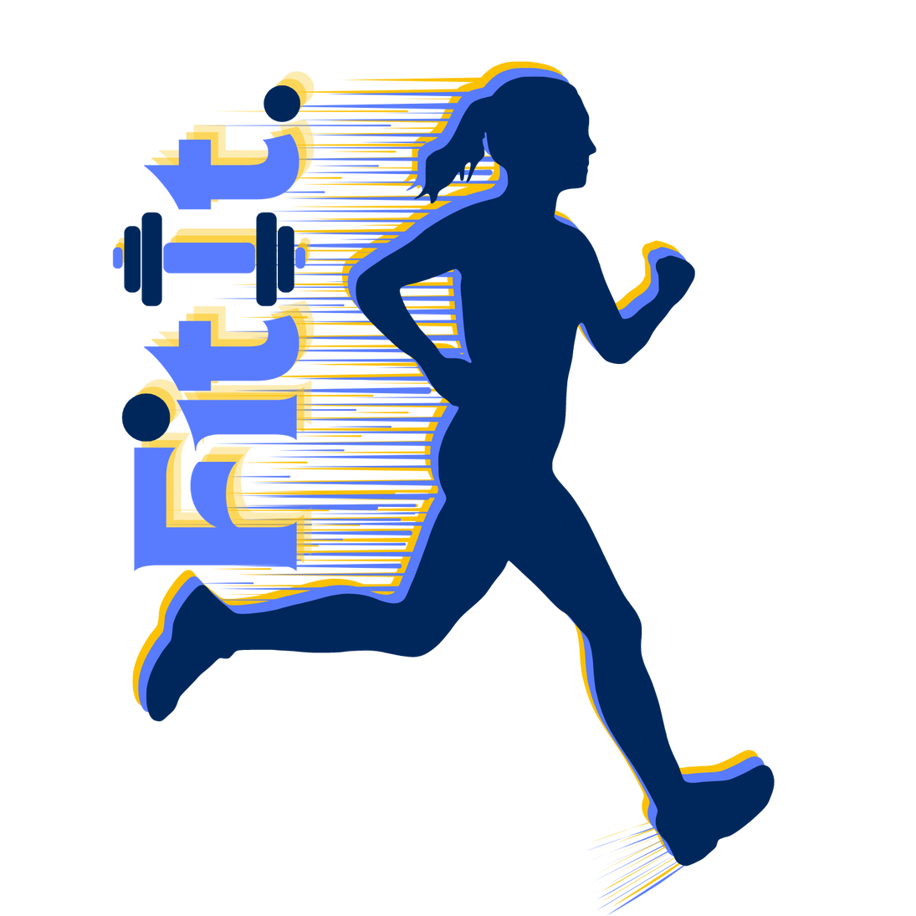

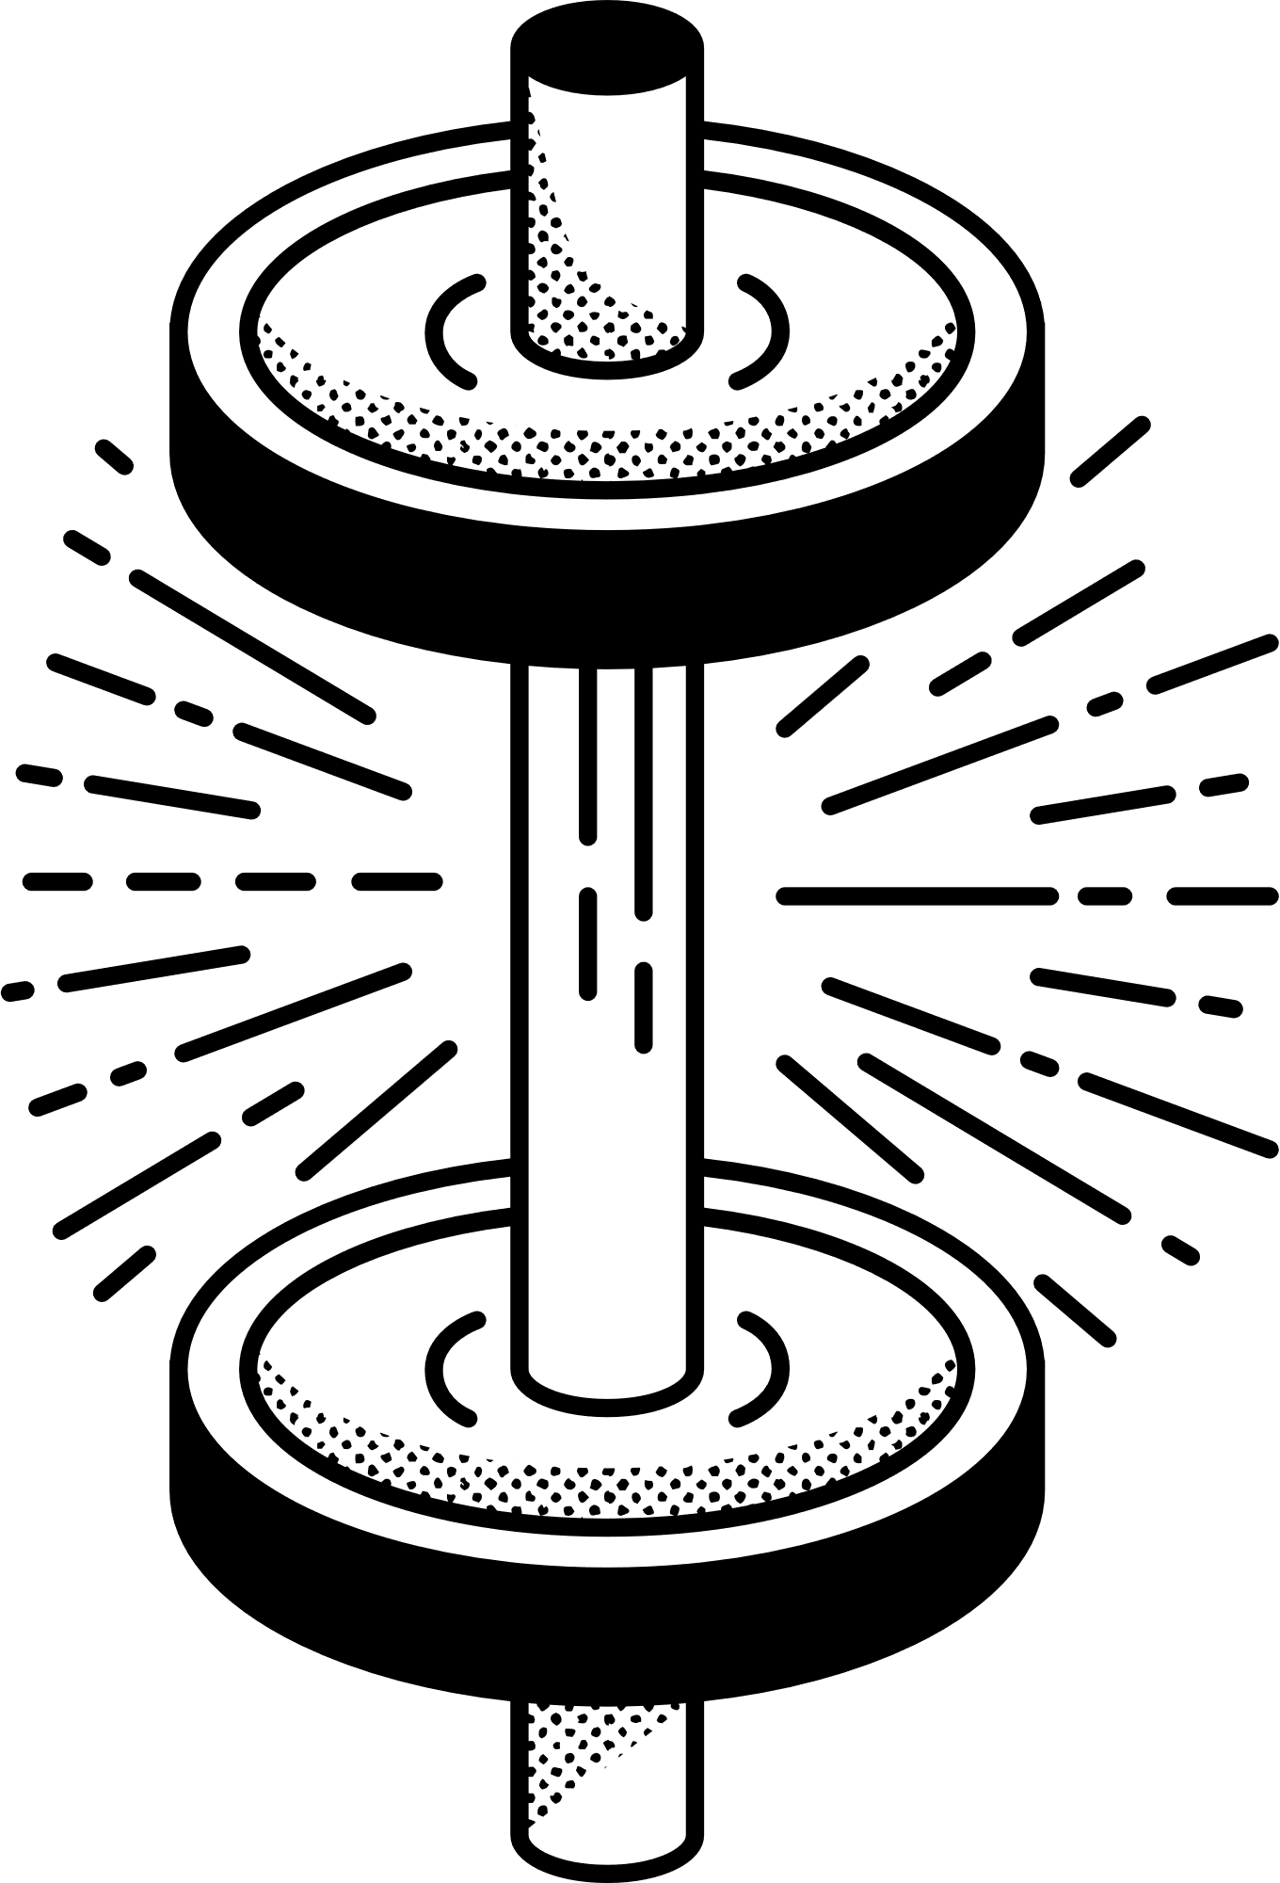


TRACK YOUR ACTIVITY EASILY
WITH “FITIT”

Slide 2
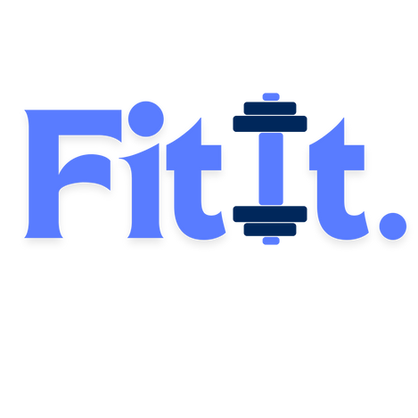


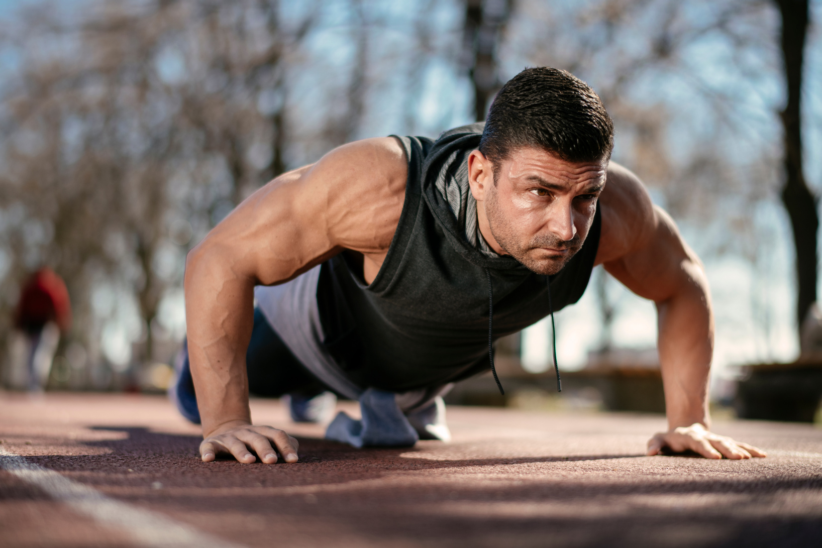
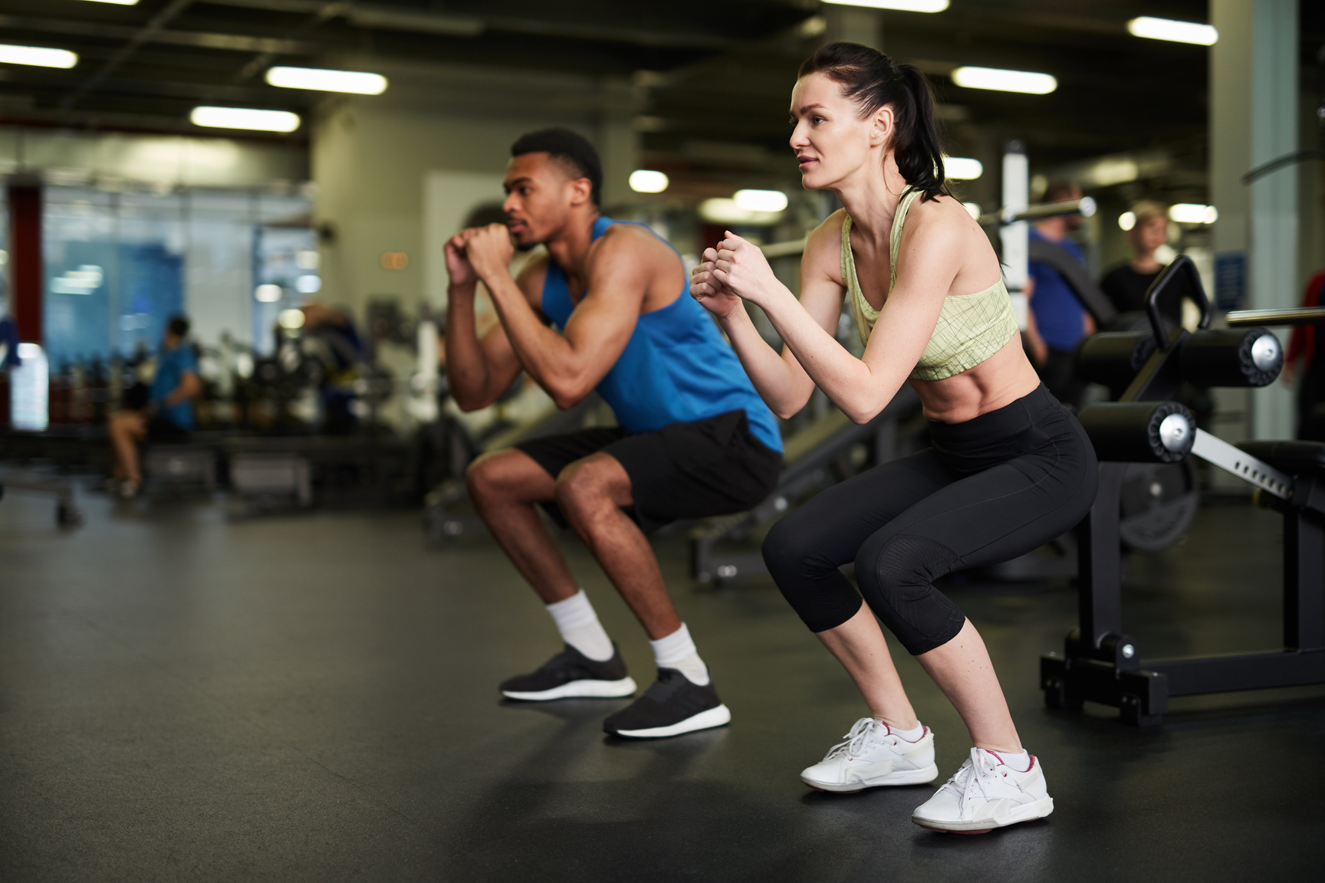


USER PERSONAS
working out in the studio
running outside
crossfit
working out with friends
Do you like to workout ?
Tired of going to the gym and not seeing results?
Want to keep track on your activities?
Our app is for you!

Slide 3
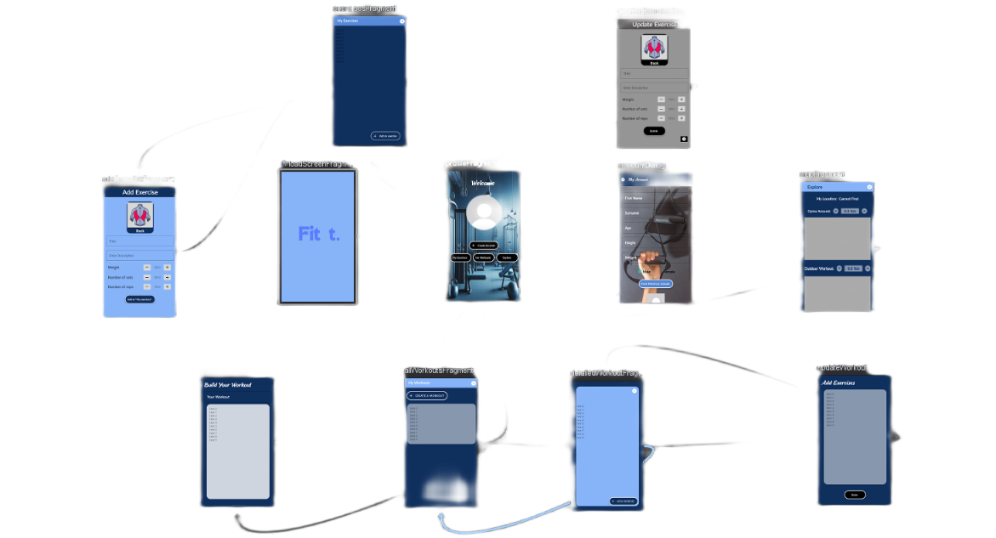
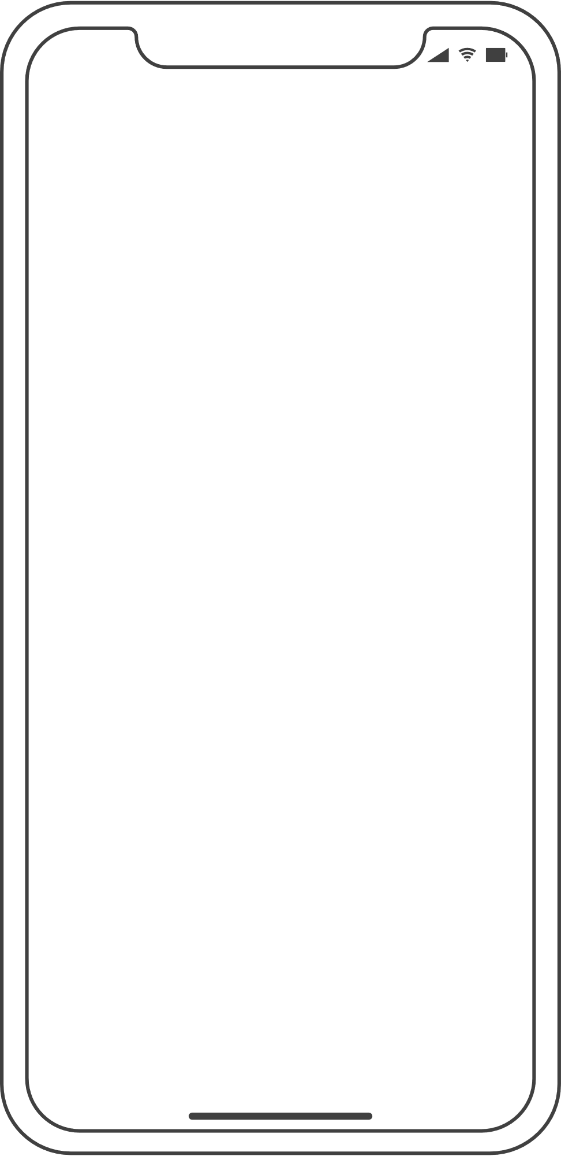

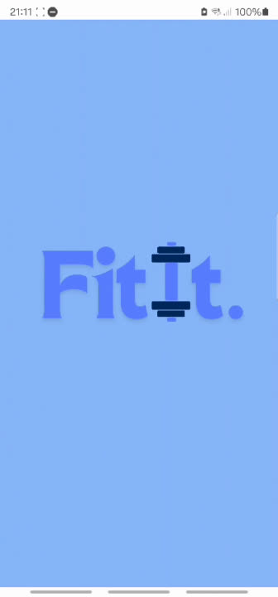
MEET “FITIT”

Slide 4
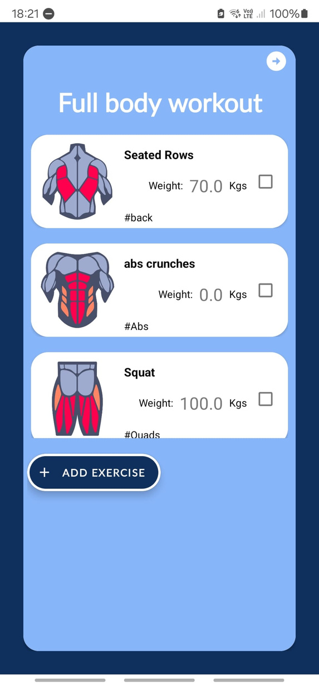
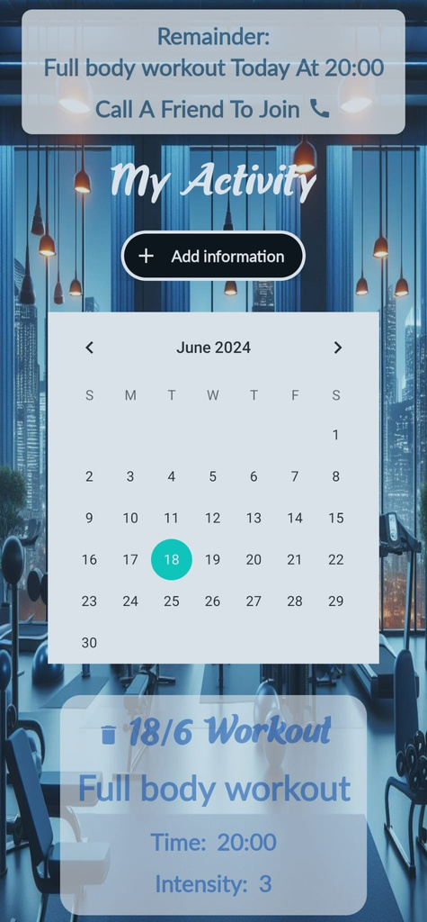
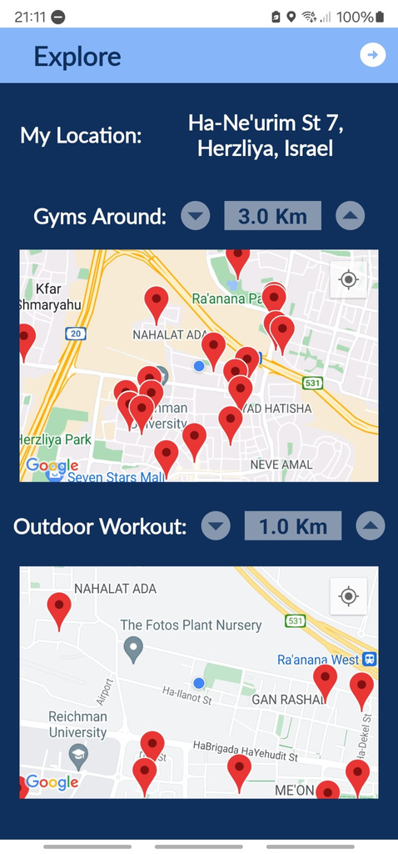
ACCESS A WHOLE WORLD WITH A CLICK
CREATE PERSONALIZED WORKOUTS
RECORD AND TRACK YOUR ACTIVITIES
EXPLORE ACTIVITIES NEARBY WITH GOOGLE MAPS

Slide 5
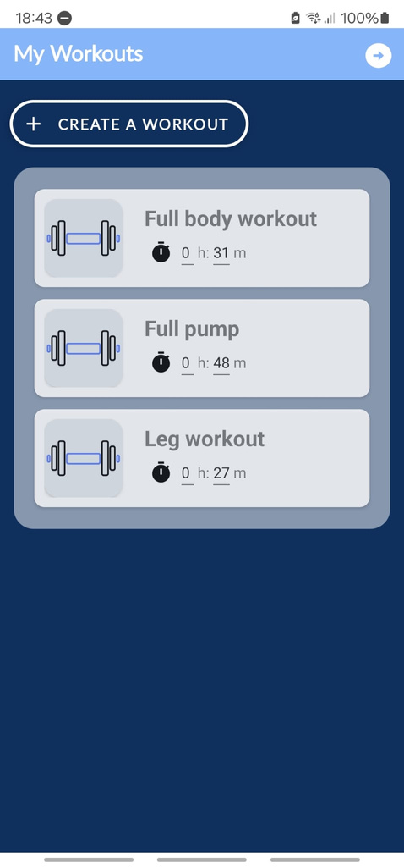
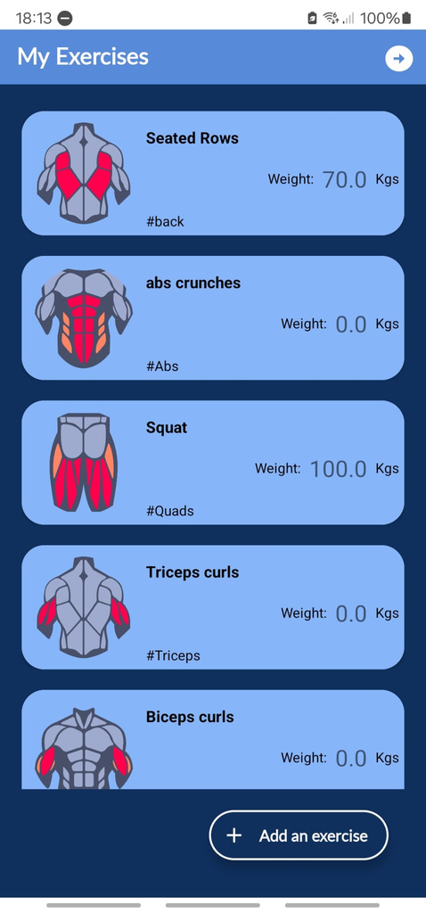
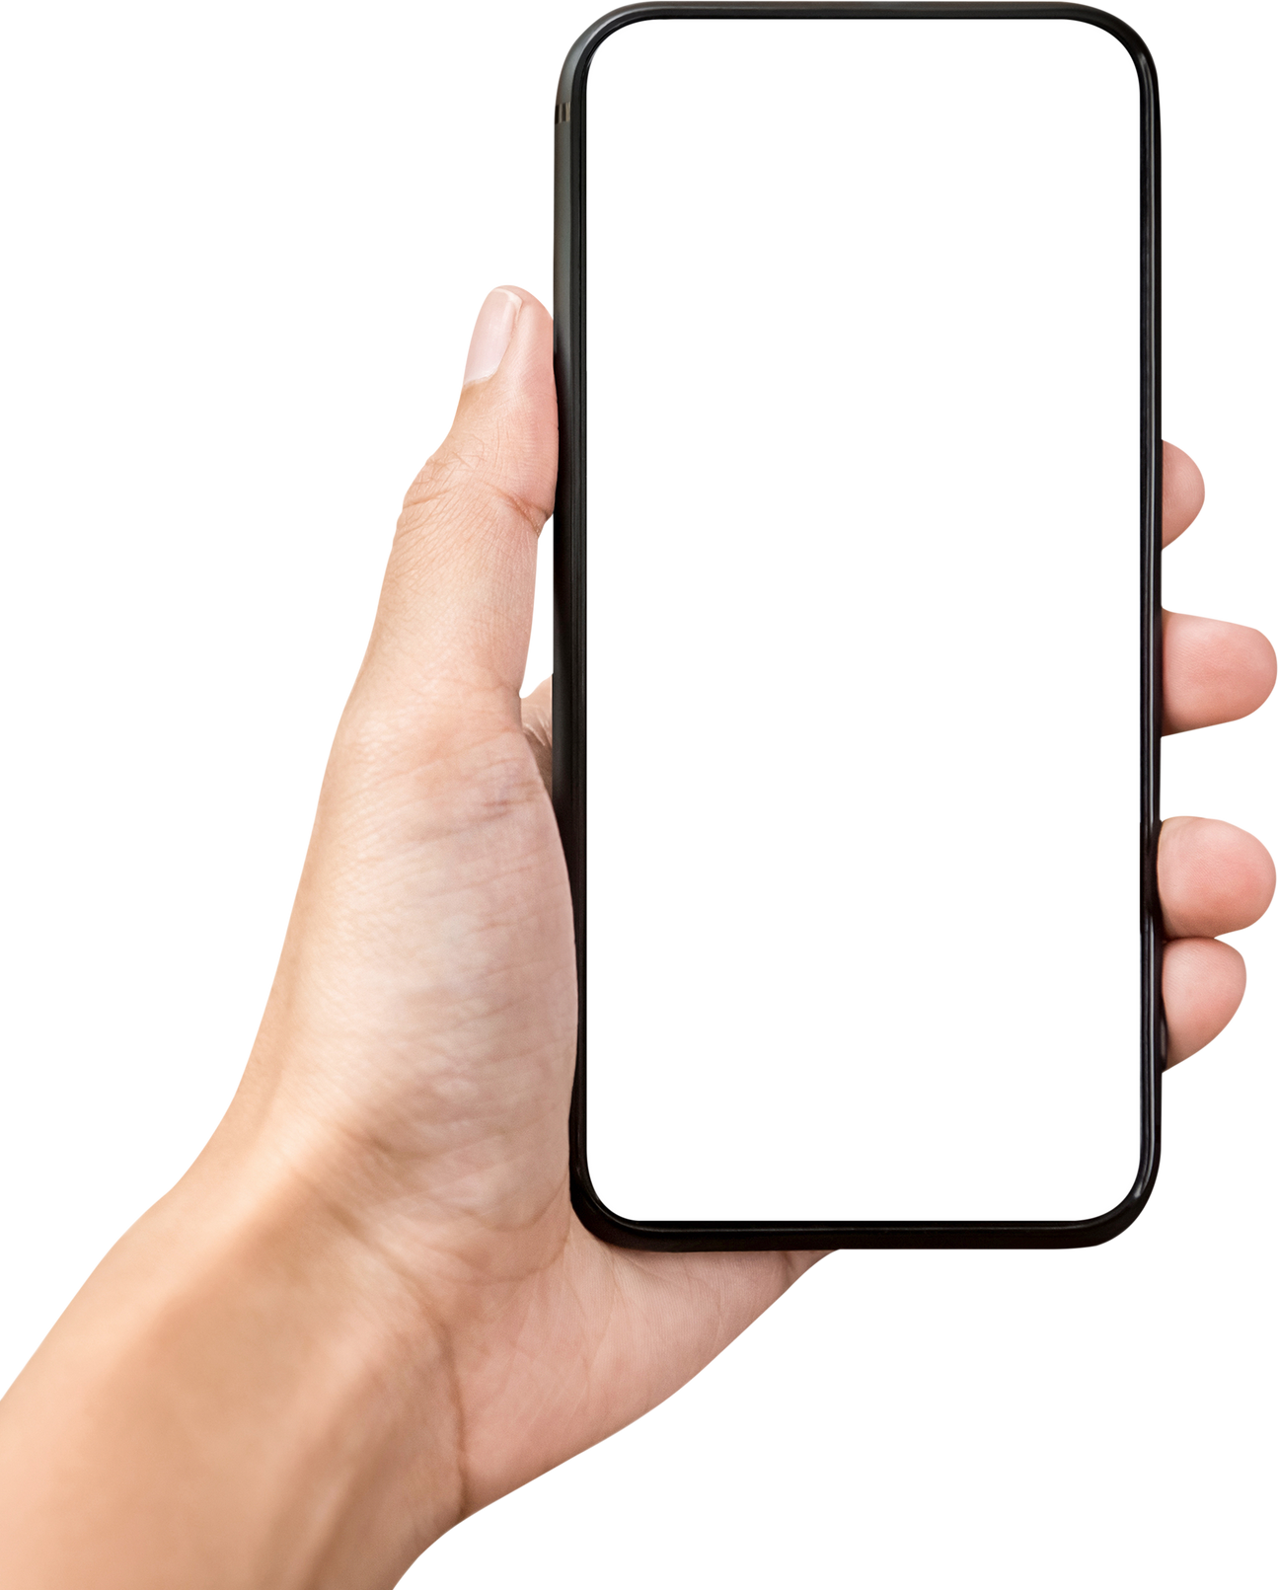
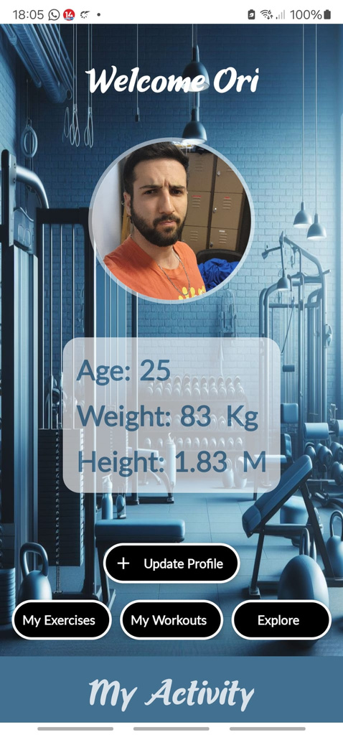
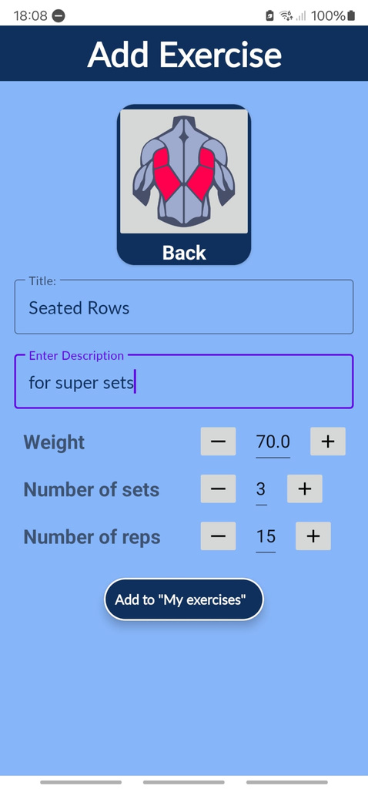



FULLY PERSONALIZED
track your personal data
add your favorite exercises
manage your exercises
create your workouts

Slide 6

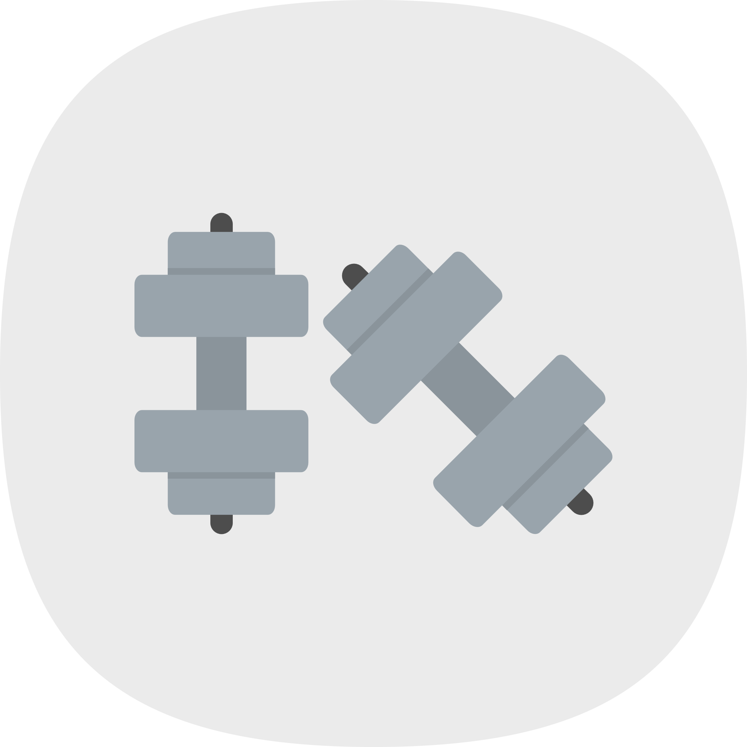


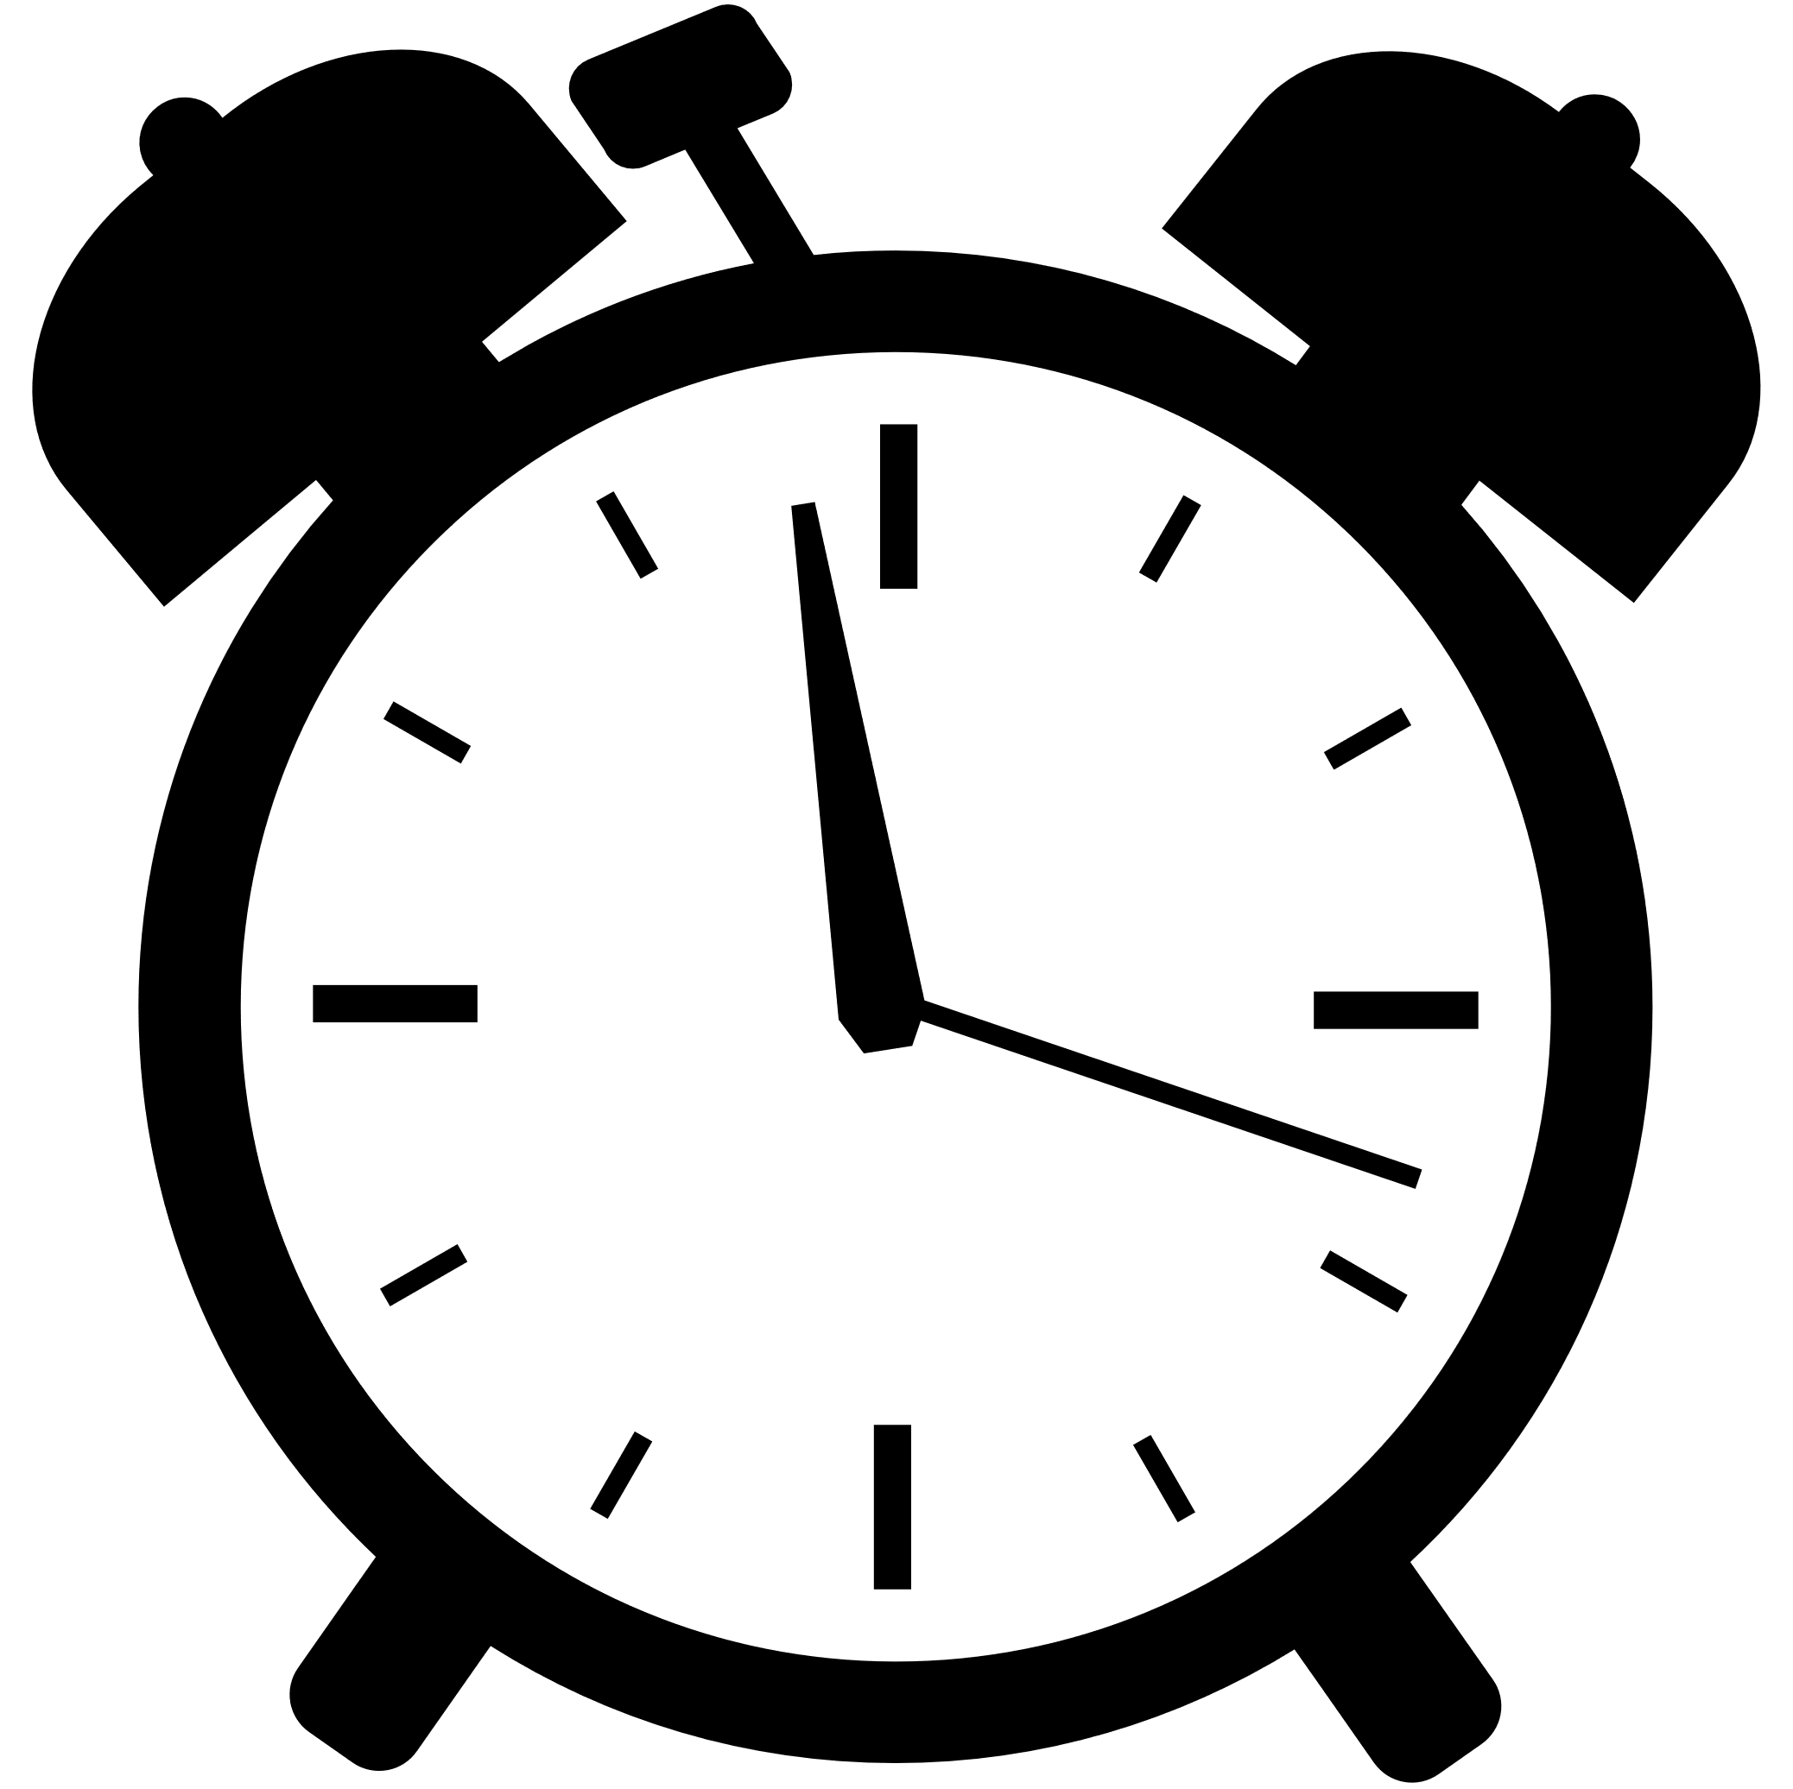

PROVIDES THE PERFECT ECOSYSTEM FOR YOUR WORKOUT
Automatically estimates the workout time based on the exercises
check exercises and track your workout in real time
Full body workout
1 : h , 33: m
long press on the workouts allow you to activate a timer that also runs on the background

Slide 7
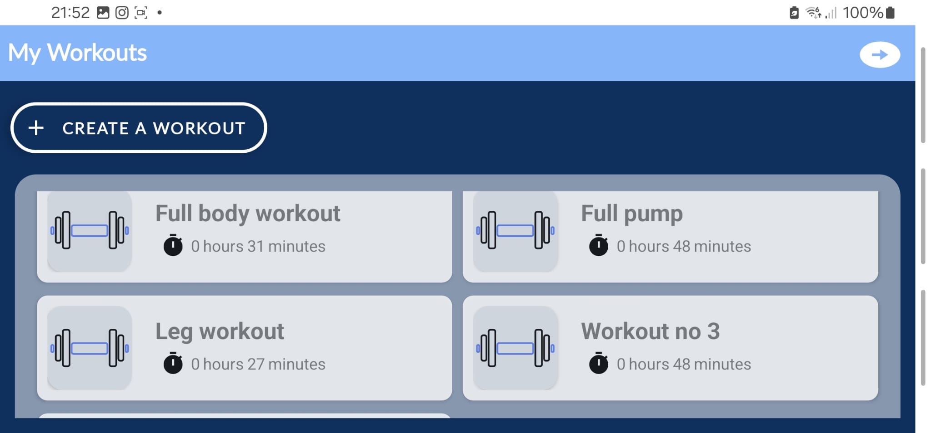
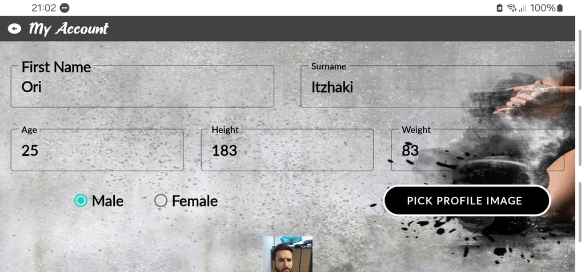
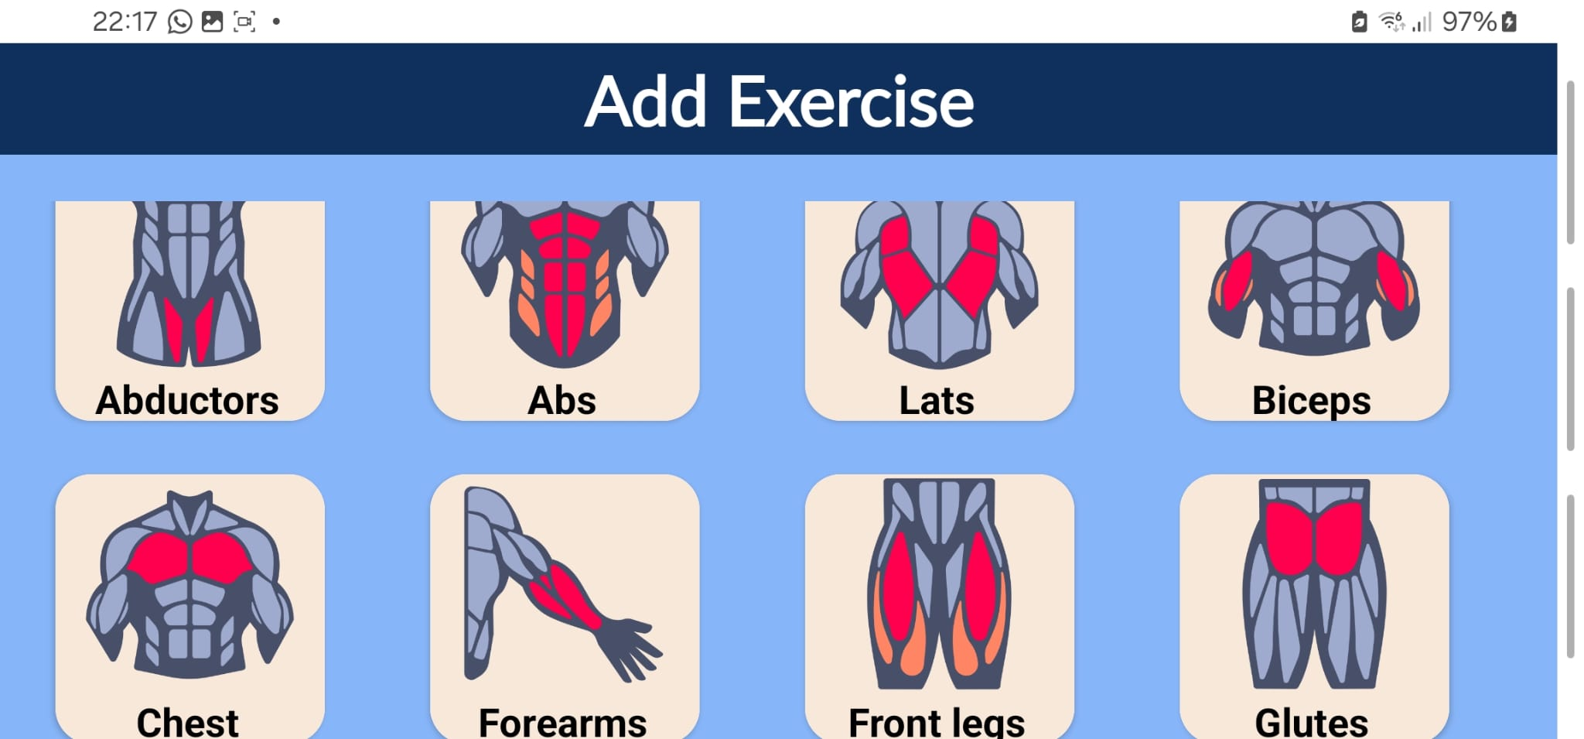
LANDSCAPE MODE COMPATIBLE
The app calculates the length of the workout for you
enjoy our incredible themes by the best designers in RUNI
Choose the main muscles
you want to target

Slide 8
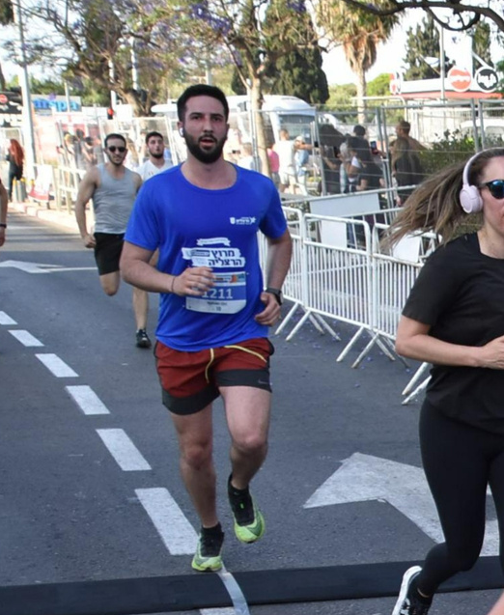


OUR TEAM
Ori Itzhaki
Mathilde Benero
Or Finkelstein
Military fitness instructor
Tennis instructor
Gym enthusiast
Tennis player

Slide 9



TECHNICAL DETAILS AND NUMBERS
1 Main Activity
Broadcast Receiver
GMS
Work Manager
Google maps
Timer background feature
Exploring nearby gyms and studios
10 Fragments
6 ViewModels
Localization + Orientation
Caller
Coroutines
The app is fully compatible in landscape mode, and is both in Hebrew and English
On the day of a scheduled workout, lets the user call a friend to join their workout
ADVANCED FEATURES
I/O operation in background threads
Room Database
Live Data
Repository
RecyclerView
Gallery
Choose a profile picture from your gallery
Navigation Components
Both workouts and exercises are implemented using Recyclerviews for a smoother ux-ui

Slide 10

THANK YOU VERY MUCH!

